Slide 1

Capstone project
Cheryl berger • Lucien Roberts • martha richardson

Slide 2


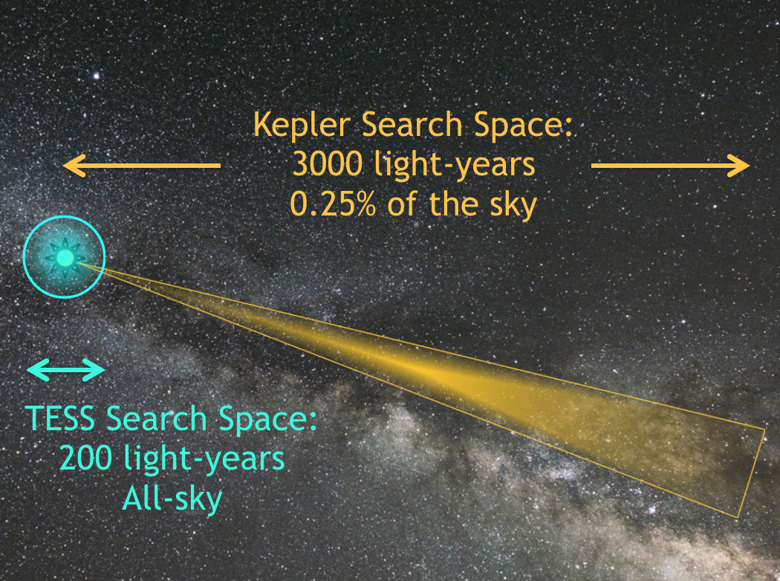


What we considered
Some datasets were too small
Some datasets were too big
We found one that was just right!

Slide 3

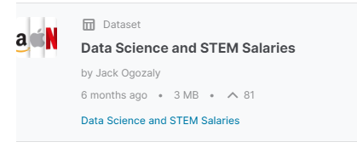
What did we choose?
Kaggle Data Science and STEM Salaries Dataset

Slide 4
Why choose this dataset?
It is extremely relevant to all of us
The dataset pretty large, needs some pre-processing, but is not so big that we have trouble storing and sharing it
There are several columns in the data we can target for different types of machine learning analysis

Slide 5
Description of dataset
62,642 rows
29 columns
Includes company name , job title, salary, bonus, stock option, gender, and race

Slide 6
What are we going to do with all this data?
Build a machine learning model to predict salaries given some input features by the user
Look for trends in current data science salaries: by location, job title, gender, race, and educational level
Consider if

